Slide 1
Artificial Intelligence (Machine Learning & Deep Learning)
{
Implementation of OOP Principals in Python
}
...

Slide 2
{
..
"First, solve the problem. Then, write the code." – John Johnson
}
..

Slide 3
Contents of Day 7
Conditional Execution & Loops
Recap & introduction | Review of Functions & Exception Handling.
Core Thoery | • Classes, Objects, Constructors, Destructors, Instance vs. Class Variables. • Inheritance (Multilevel, Hierarchical, Multiple) & Method Resolution Order (MRO). • Access Specifiers (Private, Public, Protected) & Name Mangling. • Association, Aggregation, and Composition.
Lab Practice | Practical coding tasks creating classes, instantiating objects, defining methods, and using constructors/destructors.
Advance Lab | Implementing inheritance structures, using access specifiers to secure data, and coding object relationships.
Wrap-up & Q&A | Debugging OOP logic, resolving MRO conflicts, and preparing for tomorrow's topic: Descriptive Statistics and Probability.
Important: Use of AI for solving given task is now allowed. Cellphones must be put on silent.

Slide 4
Today Objective - Classes and Objects
Why OOP matters ? When you use tools like PyTorch or TensorFlow, everything is an object. A Neural Network is a Class. The layers inside it are Objects. If you don't understand OOP, you cannot build advanced AI architectures.
Yesterday, we built individual "machines" (Functions) to perform specific tasks. Today, we are building the entire factory.
Object-Oriented Programming (OOP) allows us to bundle our data (variables) and our machines (functions) together into one organized, smart package.
}
..

Slide 5
Core Concept (Definition & Rules)
Definition:
Classes and Objects
Rules:
Class: A user-defined prototype or blueprint from which objects are created. It encapsulates data and functions into a single unit.
Object: A specific instance of a class in memory, containing actual values (state) and behaviors.
The Analogy:
The Class: A cookie cutter. It is just a design of a star; it is not food .
The Object: The actual baked cookie. You can use one cookie cutter to make 100 actual cookies.
Classes should be named using CamelCase (e.g., NeuralNetwork).
AI Application:
A NeuralNetwork class is the blueprint. The specific model predicting housing prices is the Object.The Analogy:
The Class: A cookie cutter. It is just a design of a star; it is not food .
The Object: The actual baked cookie. You can use one cookie cutter to make 100 actual cookies.

Slide 6
Core Concept (Definition & Rules)
Variables & Methods
Definition:
Instance Variables: Variables whose values are assigned uniquely to each object/instance.
Class Variables: Variables whose values are shared by all instances of a class.
Methods: Functions defined inside a class that dictate the behavior of the objects.
The Analogy (The Dog):
Instance Variables: My dog's fur color (Brown). It is unique to him.
Class Variables: Number of legs (4). It is shared by all dogs.
Methods: The action he performs, like eat(), bark(), find(),

Slide 7
Core Concept (Definition & Rules)
Constructors and Destructors
Definition:
Constructor (__init__): A special method automatically called when an object is instantiated, used to initialize the object's state.
Destructor (__del__): A method called automatically when an object is about to be destroyed, used to clean up memory.
The Analogy (The Dog):
Constructor: The "birth" setup. When a new Dog is born, it is immediately assigned a name and age before it does anything else.
Destructor: The "recycling" phase when the object is no longer needed.

Slide 8
Core Concept (Definition & Rules)
Inheritance
Definition:
A mechanism where a new class (Subclass) acquires the properties and methods of an existing class (Superclass), promoting code reusability.
Multilevel: Class C inherits from Class B, which inherits from Class A.
Hierarchical: Classes B and C both inherit from the same Class A.
Multiple: Class C inherits from both Class A and Class B.
The Analogy:
The Family Tree.
Passing down physical traits and wealth
from grandparents to parents to children
Abstraction is an oop principle that focuses on hiding complex implementation details while exposing only the essential features of an object.

Slide 9
Abstraction(hide krna)
Abstract class apni child classes sy apni koi baat mnwa skti h.
Jsy child class ko parent class k @abstractmethod ki body ko must initialize krna hoga.
Otherwise jsy ap chilCls object bnayein gy error a jay ga.
Abstract cls ka ap object nhe bna skty
Concrete method: contain a full implementation (body) and can be executed directly. concrete methods provide shared, reusable functionality.
Abstract method: methods lack a body and must be implemented by subclasses. It has @abstractmethod decorate at the top of Abstract methods in abstract classes to define a contract.
Abstract Class: two steps to make abstract cls. 1. it inherite from ABC //abstract base class. 2. have atleast one abstract method.

Slide 10
Abstraction
Key Components of Abstraction
Abstraction is primarily implemented using the built-in abc module (Abstract Base Classes).
Abstract Base Class (ABC): A blueprint for other classes that cannot be instantiated directly. To create one, a class must inherit from ABC.
Abstract Method: A method declared in an abstract class using the @abstractmethod decorator. It has no implementation and must be overridden by any concrete subclass.
Concrete Method: A fully implemented method within an abstract class that can be inherited and used directly by subclasses, promoting code reuse.
Abstract Property: Defined using @property and @abstractmethod, these enforce that subclasses implement specific attributes.
from abc import ABC, abstractmethod
# abstract class (blueprint)
class BankApp(ABC):
def databse(self): #concrete method: have full body
print("access to database")
@abstractmethod #decorder to declare abtract method
def security(self): #abtract method: have no body
pass
# concrete class (child)
class MobileApp(BankApp):
def mobile_log(self):
print("successfuly loggedIn")
def security(self):
print("mobile is secured")
mob = MobileApp()
mob.databse()
mob.security()
How to Implement Abstraction
The following steps are used to define and use abstract classes in Python:
Import the module: from abc import ABC, abstractmethod.
Define the ABC: Create a class that inherits from ABC.
Mark methods: Use @abstractmethod to define abtract methods that subclasses must implement.
Create subclasses: Implement all abstract methods in derived classes. If even one is missed, the subclass cannot be instantiated and will raise a TypeError.

Slide 11
Core Concept (Definition & Rules)
Method Resolution Order (MRO)
Definition:
The specific order in which Python searches
for base classes during the execution of a
method. It resolves conflicts in Multiple
Inheritance situations.
The Analogy:
If a child inherits rules from two
different parents, and both parents give
conflicting instructions (e.g., Eat your
vegetables!, Go play outside), MRO is the
strict rulebook telling the child exactly
which parent to listen to first.

Slide 12
Core Concept (Definition & Rules)
Access Specifiers & Name Mangling
Definition:
Keywords used to restrict the access scope of class members.
Public: Accessible from anywhere.
Protected (_var): Accessible only within the class and its subclasses.
Private (__var): Accessible only strictly within the class. Python enforces this via Name Mangling (internally altering the variable name to make it harder to access from outside).
The Analogy:
Public: Your front yard.
Protected: Your living room (family only).
Private: Your locked safe..

Slide 13
Core Concept (Definition & Rules)
Advanced Relationships
Definition:
Association: A relationship where objects interact but have completely independent lifecycles.
Aggregation: A "has-a" relationship (weak dependency). One object HAS another object, but the child can live independently. The child can exist independently of the parent.
Composition (Strong Relationship – Ownership): A "part-of" relationship (strong dependency). The child's lifecycle depends entirely on the parent.
The Analogy:
Association : A Doctor and a Patient working together.
Aggregation : A Library and Books. If the library building closes, the books still exist and can be moved.
Composition: A Car and an Engine. If you crush the car, the engine is crushed with it .

Slide 14
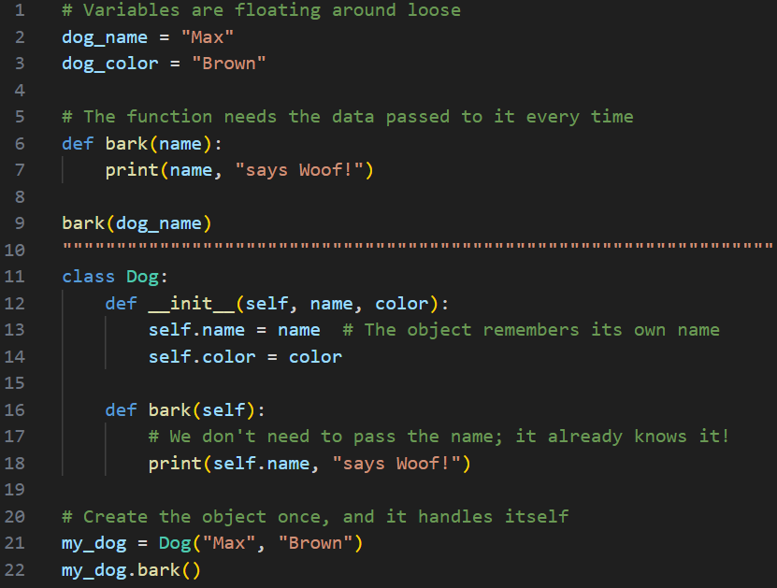
Practical exercise 01
Lab Task 1 – functions
*

Slide 15
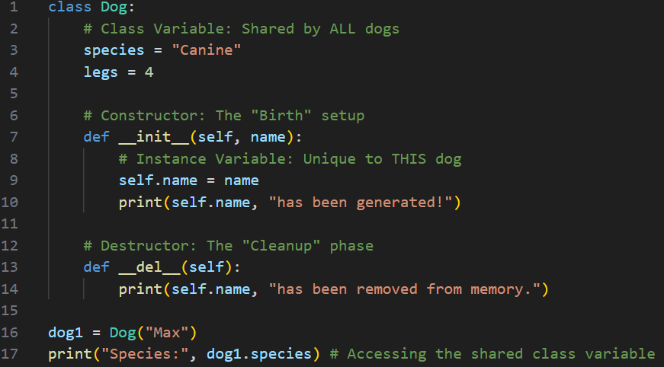
Practical exercise 02
Lab Task 2 – Variables & Constructors / Destructors
*

Slide 16
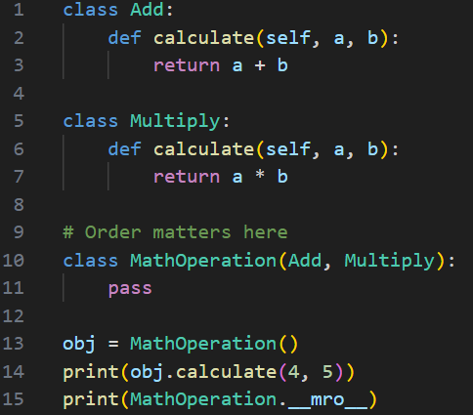
Practical exercise 03
Lab Task 3 – Inheritance & MRO
MRO (Method Resolution Order): When you call obj.calculate(4, 5), Python looks for the calculate method in MathOperation. Since it's not there (pass), it searches the parent classes from left to right.
First Match Wins: Because Add is listed before Multiply in the class definition class MathOperation(Add, Multiply), Python finds and executes Add.calculate first.
Result: It performs \(4 + 5\), resulting in 9.
__mro__: This attribute shows the exact search path Python follows: first the class itself, then its parents in order, and finally the base object class.
*

Slide 17
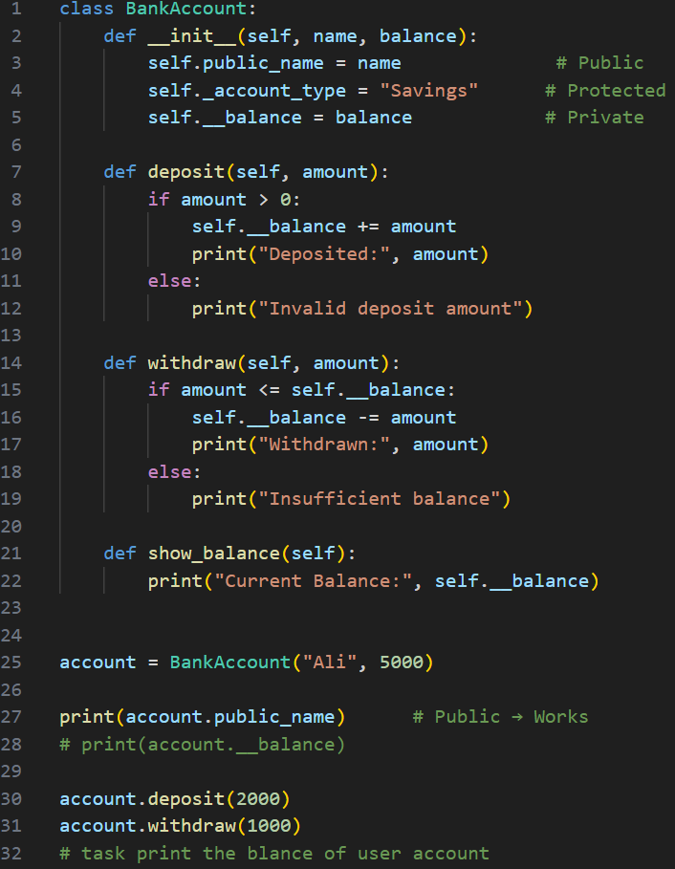
Practical exercise 04
Lab Task 4 – Specifiers / Security
*

Slide 18
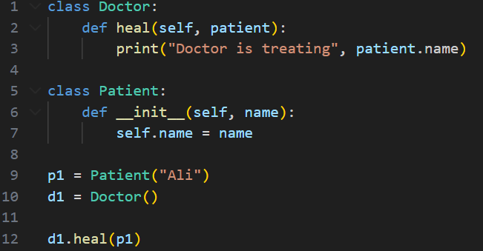
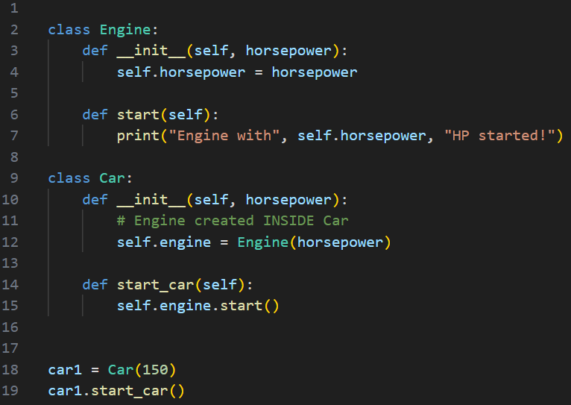
Practical exercise 05
Lab Task 5 – Advanced Relationship
*

Slide 19
Thank You for Your Focus Today!
What was the most confusing part of today's lab?
Waleed Khan (Robotics Engineer | Senior Python Developer)
Email: 0xcloudcoder@gmail.com Contact: +923126008702
}
*

